Slide 1
Powercut Resolver
Presented by:
Hari Narayan Shukla (2100910140018)
Pushpendra Singh (2100910140036)

Slide 2

Table of contents
Introduction
Problem Statement
Existing System
Hardware & software Requirements
Proposed Work
Advantages
conclusion
Table of contents

Slide 3
Introduction
Introduction
“Powercut Resolve” is a web application developed using Python and the Django framework, designed to efficiently address power outages. It provides users with a user-friendly platform to report power cuts, track their progress, and collaborate with utility companies for timely resolution. With features like real-time updates, effective communication channels, and data-driven insights, Powercut Resolve aims to streamline the reporting and resolution process, empowering users and utility companies to work together towards improving the reliability of the power supply system.

Slide 4
Problem Statement
Power outages cause significant inconvenience and disruption in our daily lives.
Reporting power outages can be a cumbersome and time-consuming process for users.
Lack of transparency and communication between users and utility companies leads to frustration and uncertainty during the resolution process.
Utility companies may struggle to manage and prioritize reported power cuts effectively.
The absence of data-driven insights hinders the identification of areas prone to frequent outages and the improvement of infrastructure.
There is a need for a user-friendly web application that streamlines the reporting process, provides real-time updates, facilitates communication, and incorporates data analytics for improved resolution of power outages.

Slide 5
Existing System
The existing system lacks a centralized platform for users to report power outages.
Users may have to rely on phone calls or physical visits to utility companies to report power cuts.
Communication between users and utility companies is limited, leading to delays in resolving power outages.
The lack of real-time updates and transparency makes it difficult for users to track the progress of their reported power cuts.
There is no data-driven analysis to identify patterns and improve the infrastructure to reduce power outages.
Existing System

Slide 6
Proposed System
Users can create accounts, authenticate themselves, and report power cuts by providing essential details.
The system facilitates effective communication and collaboration between users and utility companies.
Real-time updates are provided to users, allowing them to track the progress of their reported power cuts and receive immediate notifications regarding any additional information.
The administrative dashboard empowers utility companies to efficiently manage and prioritize reported power cuts.
Proposed System

Slide 7

HARDWARE REQUIRMENT
RAM
Minimum 4GB
Processor
From Intel Pentium IV to Latest
Back-Up
Database

Slide 8
SOFTWARE REQUIRMENT
Software used
PyCharm Community Edition.
MySQL Workbench and MySQL Shell
Front-end & Back-end
Python
Django
SQL
HTML
CSS
Javascript

Slide 9
Proposed Work
Collect feedback from users and utility companies to identify areas for improvement and implement necessary enhancements.
Continuously monitor and maintain the web application to address any issues or updates required.
Conduct thorough testing and debugging to ensure the reliability and performance of the web application.
Develop a real-time update system to keep users informed about the progress of their reported power cuts.

Slide 10
LEVEL – 0 DFD
feedback
Management
PowerCut Reporting Management
Admin Management
Powercut Resolver System
User Location Management
User Management
Login Management

Slide 11
LEVEL – 1 DFD
Customer Management
Check User
Login Details
User Location Management
Powercut Notification
Powercut Resolver System
feedback
Management
Check System Feedbacks
Login
Management
Issue Resolved
Powercut Issue
Management
Powercut Report
Admin Dashboard Management
Generate
System User Report

Slide 12
Advantages
User-friendly platform.
Real-time update.
Effective communication.
Streamlined resolution process.
Data-driven insights.
Improved reliability and satisfaction.
Scalable and robust solution.
Efficiency and coordination.

Slide 13
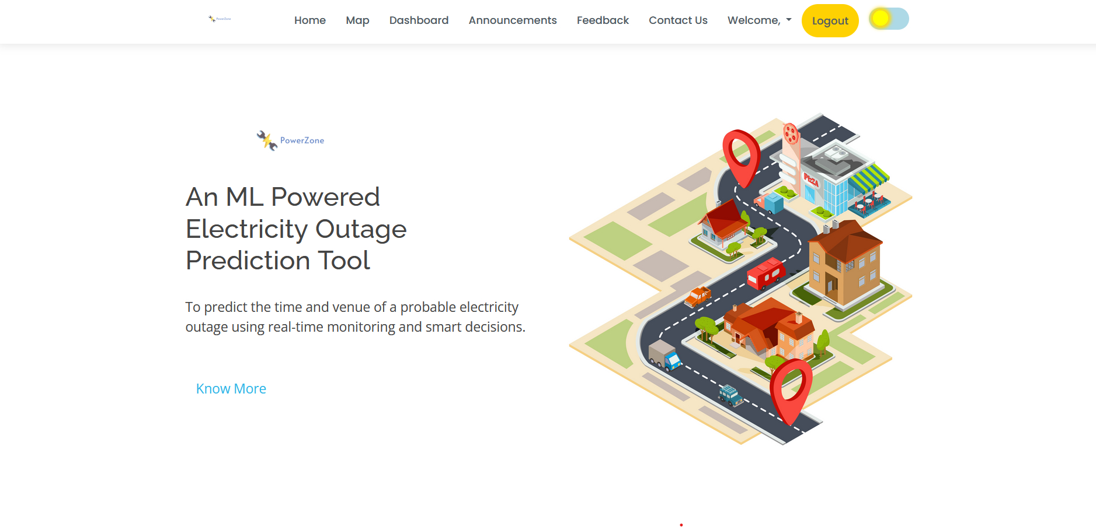
Screenshots

Slide 14
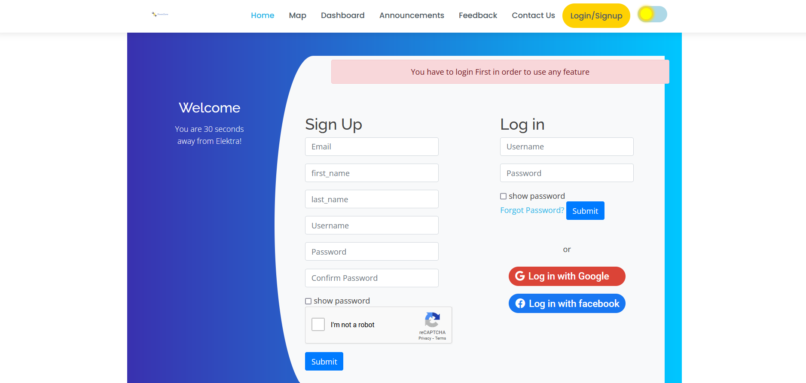
Screenshots

Slide 15
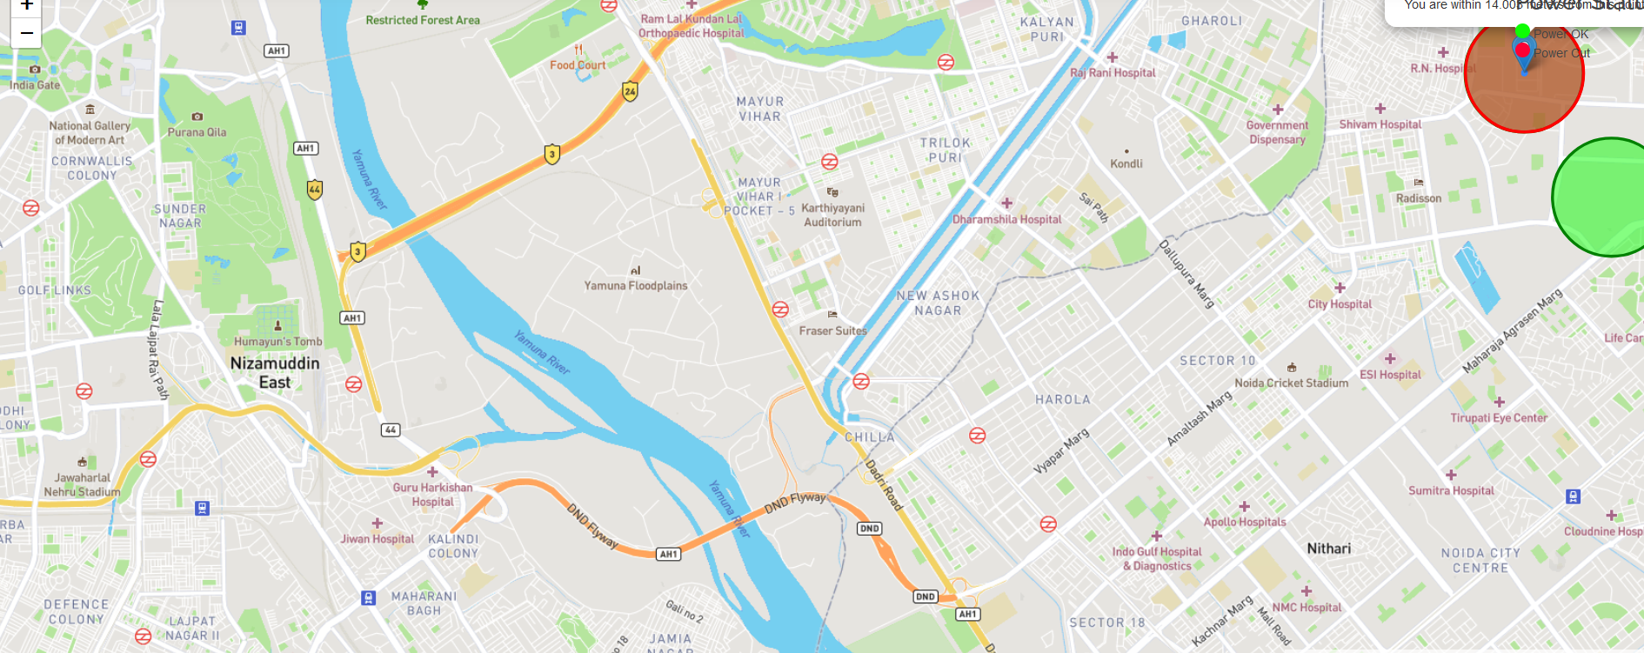
Screenshots

Slide 16
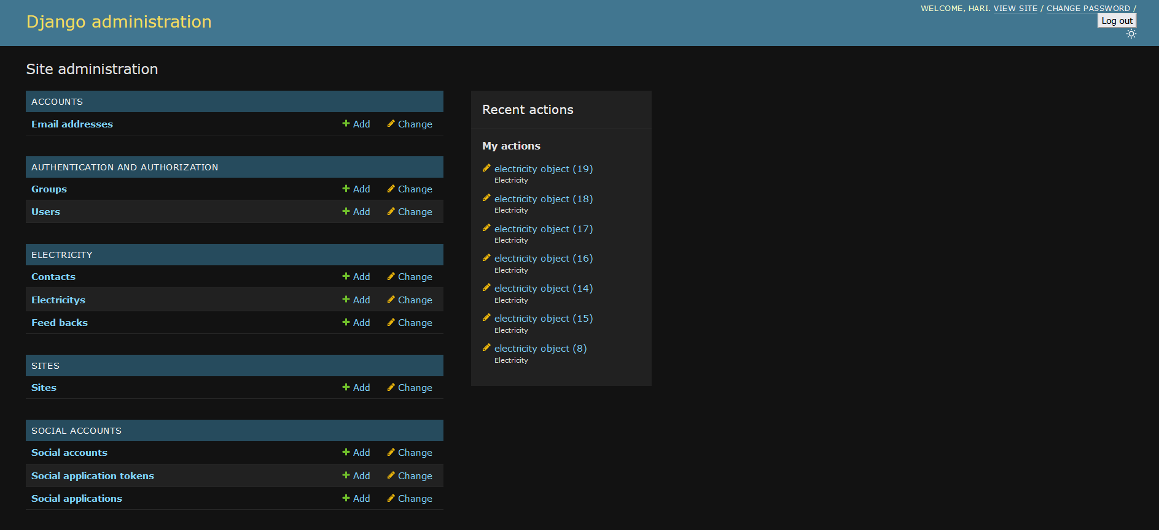
Screenshots

Slide 17
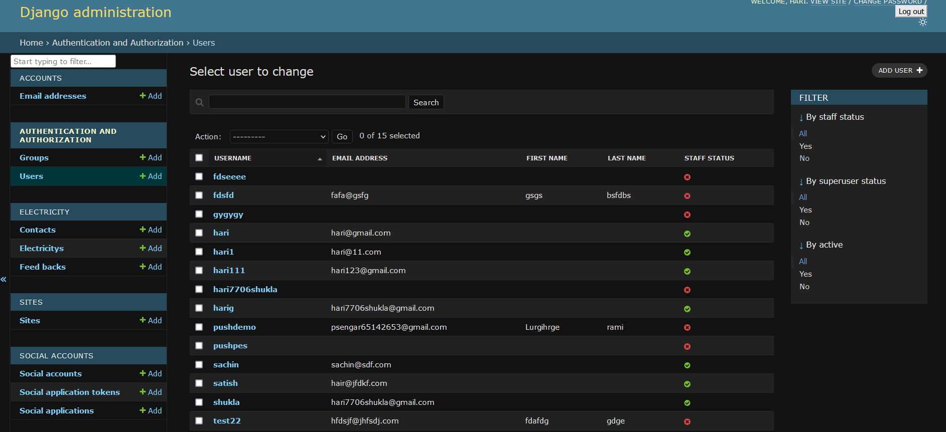
Screenshots

Slide 18
Conclusion
Powercut Resolve provides a user-friendly web application that streamlines the reporting and resolution process of power outages.
With real-time updates, effective communication, and data-driven insights, it empowers users and utility companies to collaborate efficiently, improving reliability and satisfaction in the power supply system.
By prioritizing prompt issue resolution and facilitating coordination, Powercut Resolve enhances the overall efficiency and effectiveness of resolving power cuts.

Slide 19
Thank You

